Slide 1







Customer Shopping Behavior Analytics
3,900
$233,081
ANALYZED RECORDS
NET PIPELINE SALES
An end-to-end data analytics pipeline evaluating 3,900 verified transactions to uncover high-impact customer acquisition targets, loyalty monetization opportunities, and margin protection rules.
10 Queries
79.9%
SQL HYPOTHESES TESTED
LOYAL REPEAT SHOPPERS
Lead Data Analyst • Retail Analytics & BI Specialization
Umair Asif
1 / 10

Slide 2


Architecture & Executive Summary
3-Tier Enterprise Data Stack
Core Business Objectives
Standardized raw unstructured retail records into actionable commercial strategy:
Focused on solving high-friction retail dilemmas identified in transactional logs:
✦
Monetize 2,518 Repeat Shoppers: 72.4% of loyal buyers have no active subscription.
✦
Data Preprocessing (Python): Null imputation, column normalization, multicollinearity elimination, and quantile discretization.
✦
Protect Gross Margins: 50% of hats & footwear sell on discount; establish minimum basket sizes.
✦
Relational Intelligence (MySQL): Executed 10 hypothesis tests covering demographic spend, promo codes, and frequency.
✦
Safety Stock Allocation: Prioritize high-velocity items (Blouses, Pants, Jewelry, Sandals).
✦
Executive BI (Power BI): Built an interactive operational cockpit with multi-dimensional slicing and revenue drilldowns.
1 / 10

Slide 3





Python Preprocessing & Feature Engineering
Category-Median Imputation
Schema Standardization
Imputed 37 missing ratings in Review Rating using category-specific medians, protecting the natural statistical variance.
Mapped all column names into clean snake_case (e.g., purchase_amount) for automated relational MySQL ingestion.
Multicollinearity Removal
Age & Cadence Discretization
Proved 100% equivalence between discount_applied and promo_code_used and safely dropped redundant features.
Grouped ages into 4 balanced quartiles and converted qualitative cadences into exact numeric day intervals (Weekly = 7, Monthly = 30).
1 / 10

Slide 4

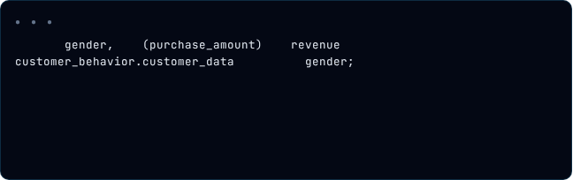



Interactive SQL Business Intelligence
Gender Sales Distribution
SELECT
SUM
AS
FROM
Male customers generate the vast majority of volume ($157.9K). Targeted female acquisition campaigns represent the largest untapped expansion opportunity.
-- Male: $157,890 (67.7%) | Female: $75,191 (32.3%)
GROUP BY
$157.9K
$75.2K
MALE REVENUE
FEMALE REVENUE
1 / 10

Slide 5
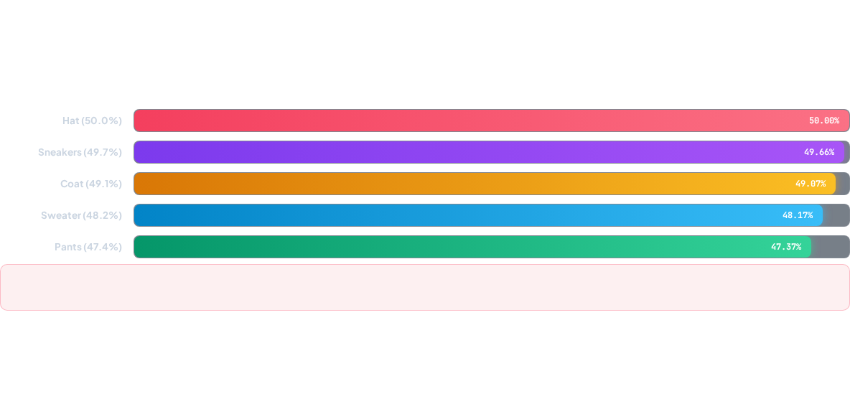
Product Discount Utilization Rate
Margin Threat Identified (SQL Q2): High-value shoppers spend up to $97 per transaction even with discounts applied. Establishing a strict $65+ cart minimum for coupon eligibility protects profitability without suppressing conversion.
1 / 10

Slide 6



Customer Segmentation Breakdown
High-Retention Retail Ecosystem
SQL Q7 confirms exceptional repeat buyer stickiness with minimal one-off transactional churn:
Segment | Threshold | Count | Share
Loyal | > 10 Purchases | 3,116 | 79.9%
Returning | 2 to 10 Purchases | 701 | 18.0%
New | 1 Purchase | 83 | 2.1%
Loyal Shoppers (>10 Orders)
Representing 79.9% of Total Customer Base
1 / 10

Slide 7


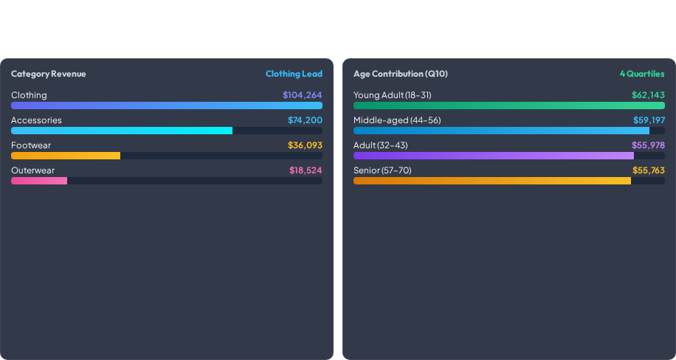






Interactive Power BI Executive Dashboard
GENDER SLICER
3,900
$233,081
$59.76
TOTAL CUSTOMERS
GROSS REVENUE
AVERAGE BASKET
SUBSCRIPTION
1 / 10

Slide 8



Interactive Loyalty Conversion Calculator
Monetize 2,518 Repeat Buyers
72.4% of loyal repeat customers (>5 orders) have no active subscription. Adjust the target conversion rate to project annual recurring VIP revenue:
PROJECTED NET NEW ARR
VIP Conversion Rate: 15%
5% (Conservative) 25% (Target) 50% (Aggressive)
From 378 Converted VIP Members
$60/yr VIP Membership
1,431 Shoppers
1 / 10

Slide 9



Top Products & SKU Performance
Clothing Volume
Accessories Volume
Footwear Volume
Top Rated SKUs (SQL Q3): Gloves (3.86★), Sandals (3.84★), Boots (3.82★), Hat (3.80★)
1 / 10

Slide 10



Strategic Executive Action Plan
1. VIP Conversion
2. $65+ Basket Floor
3. Inventory Priority
Deploy checkout prompts targeting 2,518 repeat non-subscribers with free express shipping ($60.48 AOV) to capture +$22.6K ARR.
Enforce minimum order values on promo codes to prevent margin dilution on high-discount SKUs like Hats and Sneakers.
Maintain buffer safety stock on high-velocity SKUs (Blouses, Pants, Jewelry, Sandals) while balancing promo runs.
Ready for Technical & Strategic Q&A
Umair Asif • End-to-End Retail Data Analytics & Business Intelligence Portfolio
1 / 10

